Slide 1
Session Tracking
Managing Session in Servlets
We all know that HTTP is a stateless protocol. All requests and responses are independent. But sometimes you need to keep track of client's activity across multiple requests. For eg. When a User logs into your website, not matter on which web page he visits after logging in, his credentials will be with the server, until he logs out. So this is managed by creating a session.
Session Management is a mechanism used by the Web container to store session information for a particular user. There are four different techniques used by Servlet application for session management. They are as follows:
Cookies
Hidden form field
URL Rewriting
HttpSession
Session is used to store everything that we can get from the client from all the requests the client makes.

Slide 2
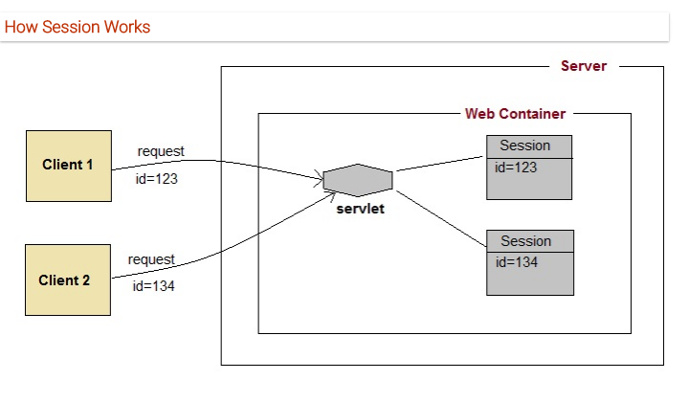
Session Tracking

Slide 3
Session Tracking
The basic concept behind session is, whenever a user starts using our application, we can save a unique identification information about him, in an object which is available throughout the application, until its destroyed.
So wherever the user goes, we will always have his information and we can always manage which user is doing what. Whenever a user wants to exit from your application, destroy the object with his information.

Slide 4
Session Tracking
What is HttpSession?
HttpSession object is used to store entire session with a specific client. We can store, retrieve and remove attribute from HttpSession object. Any servlet can have access to HttpSession object throughout the getSession() method of the HttpServletRequest object.

Slide 5
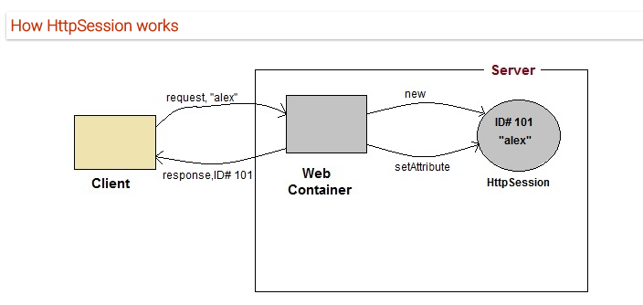
Session Tracking

Slide 6
Session Tracking
On client's first request, the Web Container generates a unique session ID and gives it back to the client with response.
This is a temporary session created by web container.
The client sends back the session ID with each request. Making it easier for the web container to identify where the request is coming from.
The Web Container uses this ID, finds the matching session with the ID and associates the session with the request.

Slide 7
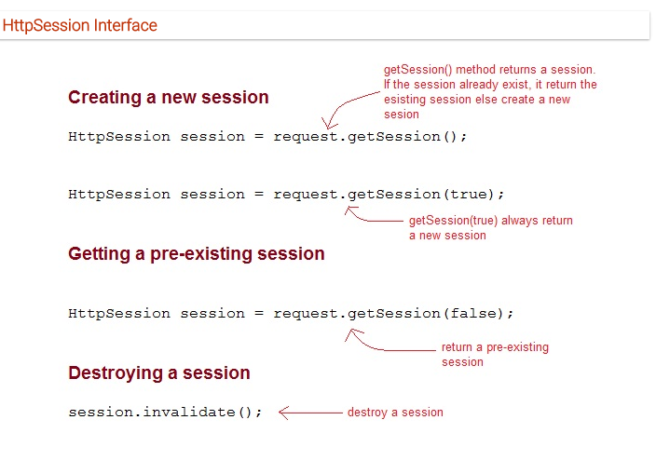

Slide 8
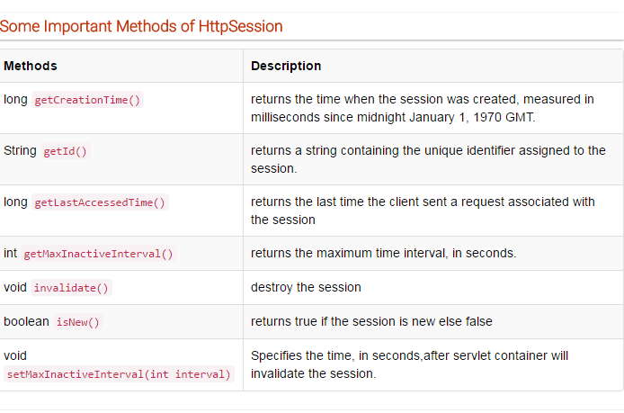
Session Tracking

Slide 9
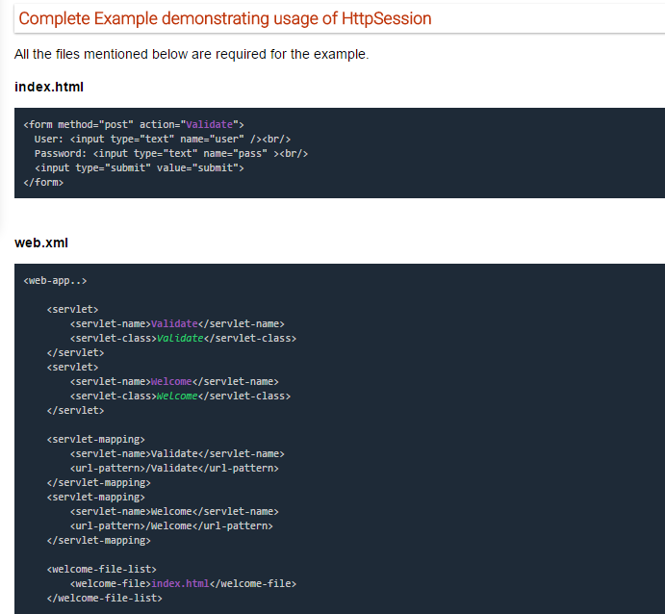
Session Tracking

Slide 10
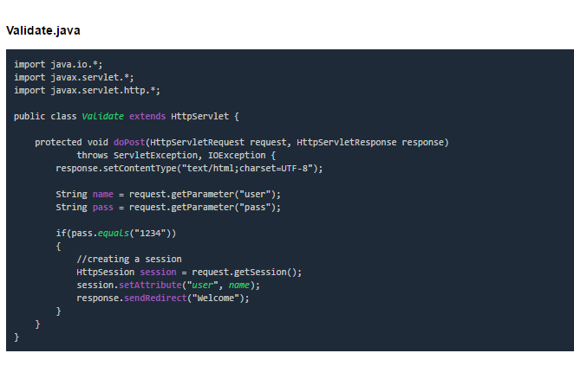

Slide 11
